Slide 1
AI based Image Analyzer
David Kirsh
Cognitive Science
UCSD

Slide 2
Topics
AI is changing how we research
What it does
Physical Tagging
Psych, Neuro, Social Tagging
Functionality
Multi-modal interactions

Slide 3
Technology is changing how we can do research
In the last 3.5 weeks, with the help of AI, I was able to design and mostly build an AI platform that can:
Automatically process thousands of images quickly,
Tag them with 1000’s of architecturally meaningful tags
Infer which are good or bad for a range of cognitive, emotional, neural states and for social interaction
Compare design alternatives we upload wrt specific objectives – good for iterative design
See how different spaces are likely to affect stress, attention, or creativity to name a few states we care about – learn how diverse ‘creative’ spaces might be

Slide 4
Why I wanted this initially
Experiments works with specific – usually simplified – stimuli
Is X more restorative than Y
Where X is a biophilic env – ie with plants (but rarely does it use a metric to measure ‘how biophilic’ and Env is
But I want to see 100’s or 1000’s of such environments (eg biophilic envs)
I want to understand the design space of biophilic additions
I want to develop intuitions maybe that architects already have
I want intuitions when things might interact or have to be within bounds
Eg. Do people tend to prefer curvy spaces only for certain sorts of social interaction? Or do they like them more in general, almost all of the time?
OK. But what are the constraints on the radius of curvature
Do they like round rooms
Or rooms that snake around or curvy corridors?
This helps us find good ideas for experiments and to see possible stimuli

Slide 5
Example

Slide 6
What is known already?
AI can read 1000-2000 papers selected using AI for relevance to questions we have
Given an activity, and a target cog, emotional, or neural state what sort of architectural designs will have an effect and in what direction?
We can reverse the question: what is known about the effect of large leaved plants on people (e.g. fiddle leaf fig)
Then we can find gaps, look for methods & experimental paradigms already in use

Slide 7
How we might talk to it
Me: “I need stimuli that are high creativity but low crowding, with natural textures and moderate visual complexity.”
IA “Found 180 candidates; here are 60 most diverse by material palette. I also prepared two contrast sets:
high creativity + high complexity,
high creativity + low complexity.
Do you want to equalize daylight and ceiling height across sets?”
Me: “Yes. Also add a control set with low creativity but excellent daylight to isolate complexity.”
IA: “Done. Four balanced sets exported with thumbnails, metadata, and predicted scores.”

Slide 8
Experiment design on demand
Query 100k+ interiors for stimulus sets that match psychological targets
To study creativity,
top 60 images predicted high-creativity;
30 mid;
30 low as controls,
All with controllable diversity and covariate balance so we could study the effect of adding or subtracting attributes

Slide 9
Non-linear, interaction-aware reasoning
Factors aren’t treated as linear sums;
Reasoning engine models synergies e.g., daylight × material warmth
Models antagonisms e.g., visual clutter undermining biophilia
Tries to predict complex interactions

Slide 10
Editable schema → evolving science
Add new factors/tags
‘perceivable affordances for dyadic conversation’ from the GUI;
the whole pipeline (features → weights → predictions) updates without code.

Slide 11
At-scale pattern discovery
Mine >100k images to map factor co-occurrences, segment typologies, and surface surprising precedents that challenge designer priors.

Slide 13
Can we infer interactions

Slide 14
Wouldn’t it be nice if we had an AI image analyzer that could
Show me images of spaces that:
Facilitate creativity
Restorative – reduce stress
Conducive to well being
Helpful for concentration
Awe inducing
Show me images of a curvilinear dining room with a high ceiling and granite floor
What are the psych attributes of this image
AI analyzes images of the built environment.
Physical Tags
You can ask it to show images of bathrooms or curvey walls, or wooden floors
Or psychological or neuro tags (labels)

Slide 15
Specification

Slide 16
Show me spaces that are good for ….?
AI Agent for Architecture
Question
Answer
Show me 50 very different restorative spaces
Show me bathrooms with floor to ceiling windows
Show me rooms that are good for 3 person conversations

Slide 17
What do you think of this image?
AI Agent for Architecture
Assessment
Words (psych, neuro, social)
Images
Words + images
Image + query
Queries
What are the psych attributes of this space
Show me images of space similar to this but better for tranquility, creativity, discussion …
Show me physically similar images or psychologically similar
Reasoning
What sort of lighting might improve the tranquility, creativity, relaxation, discussion, …
What sort of flooring, wall colors, wall materials might improve the focus, tranquility, creativity, discussion …

Slide 18
Multi-modal interaction
What might ruin the nice properties of this space
AI Agent for Architecture
Answer
Words
Images
Words + images
Image + query
What acoustics would ruin the restorative properties of this space?
What other properties must we avoid?

Slide 19
How does it work - Modules

Slide 20
Tagging Physical Elements

Slide 21
Tagging Relevant Physical Elements of Spaces/Images
Tags from Analysis of CNfA Literature
Experimental, theoretical literature on CNfA.
Physical elements of stimuli used in the literature
100K image Dbase
Input source for the system
VLM and LLM tagging
Applies vision and language models to tag images with their physical (objective visual) attributes
Tags from Taxonomies
of architectural visual properties and room types, materials, etc
Compare images to identify physical differences = new tags
Tags from Architectural programs or Architects
Visible building elements, materials, etc
{Theory of tag correlation needed}

Slide 22
Tagging Psych, Neuro attributes

Slide 23

Tagging Images by their Psych and Neuro properties
Generating Knowledge Base
AI Analysis of Technical Literature
Experimental, theoretical literature on CNfA
Physically Tagged Images
Knowledge Base
Physical Tags → Psych / Neuro
How restorative/stressful, creative, awe-inducing, easy to wayfind, visual noise/complexity, emotion type …
Integrate results
Propose ‘validation’ Experiments
Subjective preference tests of envs according to team of experts, Human Evaluations
(P₁, P₂ … P_{n} → _{1,} ₂ …. _{n} )
(P₁, P₂ … P_{n} → N₁ , N₂ , … N_{n} )
Sort ABC according to stressfulness

Slide 24
Tagging Social Attributes

Slide 25
Basic Question
How do architectural elements (tags) like:
spatial layout,
corridors, stairwells, entryways ... transitional space
circulation patterns,
lighting,
acoustics,
furniture arrangement, circular seating, row seating
public lobby, …
View (complicated), visual openness, partitioned spaces
Typology: retail, hospital, school …
influence the diverse forms of social interaction

Slide 26
Physical → Social
Physical Tags | Social Interaction
open, lounge-like areas | more likely short, casual chats
private or semi-private conference areas, perhaps with appropriate soundproofing and ergonomic furniture | formal, long, cognitively intense tasks
Corridors, stairwells, entryways | short but frequent interactions

Slide 27
Key Dimensions of Social Interaction to be predicted
Duration
Brief or Ephemeral Interactions: Quick exchanges such as greeting or asking for directions.
Extended or Ongoing Interactions: Conversations, collaborative tasks, meetings.
Participant Count
Dyadic (2-Person) Interactions: Pairs talking or working together.
Small Groups (3–6 People): Informal gatherings, brainstorming sessions, casual meet-ups.
Large Groups (7+ People): Presentations, lectures, social events.
Nature or Purpose of Interaction
Task-Oriented: Goal-driven conversations, collaborative work, problem-solving.
Social-Emotional: Friendly chats, bonding moments, emotional support.
Observational/Peripheral: People watching, eavesdropping, incidental interactions while passing by.

Slide 28
Key Dimensions of Social Interaction to be predicted
Level of Formality
Formal: Structured settings (classrooms, conference rooms, offices), official events.
Informal: Hallway chats, cafe conversations, recreational or leisure spaces.
Spatial Context
Public vs. Private: Public lobbies vs. secluded office corners.
Physical: Transition Spaces: Corridors, stairwells, entryways
Prediction: encourage short but frequent interactions.
Physical: Dedicated Interaction Zones: Lounges, meeting rooms, dining areas
Prediction: encourage longer, more focused engagement.
Physical Arrangement & Proximity
Seating Layout: Circular seating encourages inclusivity; rows encourage more formal, one-way communication.
Density/Crowding: High-density areas can amplify or inhibit social interaction.
Access & Visibility: Visual openness can facilitate chance encounters; partitioned spaces can foster privacy or limit visibility.

Slide 29
*** Tagging Images by their Social Properties
Generating Knowledge Base
AI Analysis of Technical Literature
Experimental, theoretical literature on CNfA
Physically Tagged Images
Knowledge Base
Physical Tags → Social parameters (given a set of social dimensions)
Integrate results
Propose ‘validation’ Experiments
Subjective preference tests of envs according to team of experts – Human Evaluations
Sort ABC according to ‘typical duration’

Slide 30
Inferring (& Tagging) a Space’s Functionality
Tagging the activities it supports and how well

Slide 31
Theory driven analysis of the potential activity spaces in a physical space
Image
Functional Analysis
Activity Space Analysis of each Activity in that room
Bldg/ Room
Typologies
How good is this space for supporting Activity A₁, A₂ … A_{n}
Typical Activities

Slide 32
Tagging complexities
Get Chat to create a physical and functional collection of tags – possible with:
Shapes, regions, structural properties, materials on walls, materials on floors, lighting, windows, view through the window, time of day, - ask it to think of all the identifiable tags in a room that might possibly be factors in the psych and activity related implications of a room/space.
Have it develop a similarity function that compares two or more images according to their relevant similarity where similiarity metric is sensitive to what the user wants – similar in function, similar in restorativeness – with a slider that shows these examples either maximally diverse first or maximally similar. Or perhaps have that slider on the results page of thumbnails.

Slide 33
Remember to compute thumbnails for all images in advance
Discuss dbase design
Make sure that as much is being precomputed as possible, maybe some of the precomputed values can be done by distributed the task to different LLMs, VLM’s to minimize cost

Slide 34
Cost minimization
Whole topic of how to divide the tagging and inference to different models to min cost

Slide 35
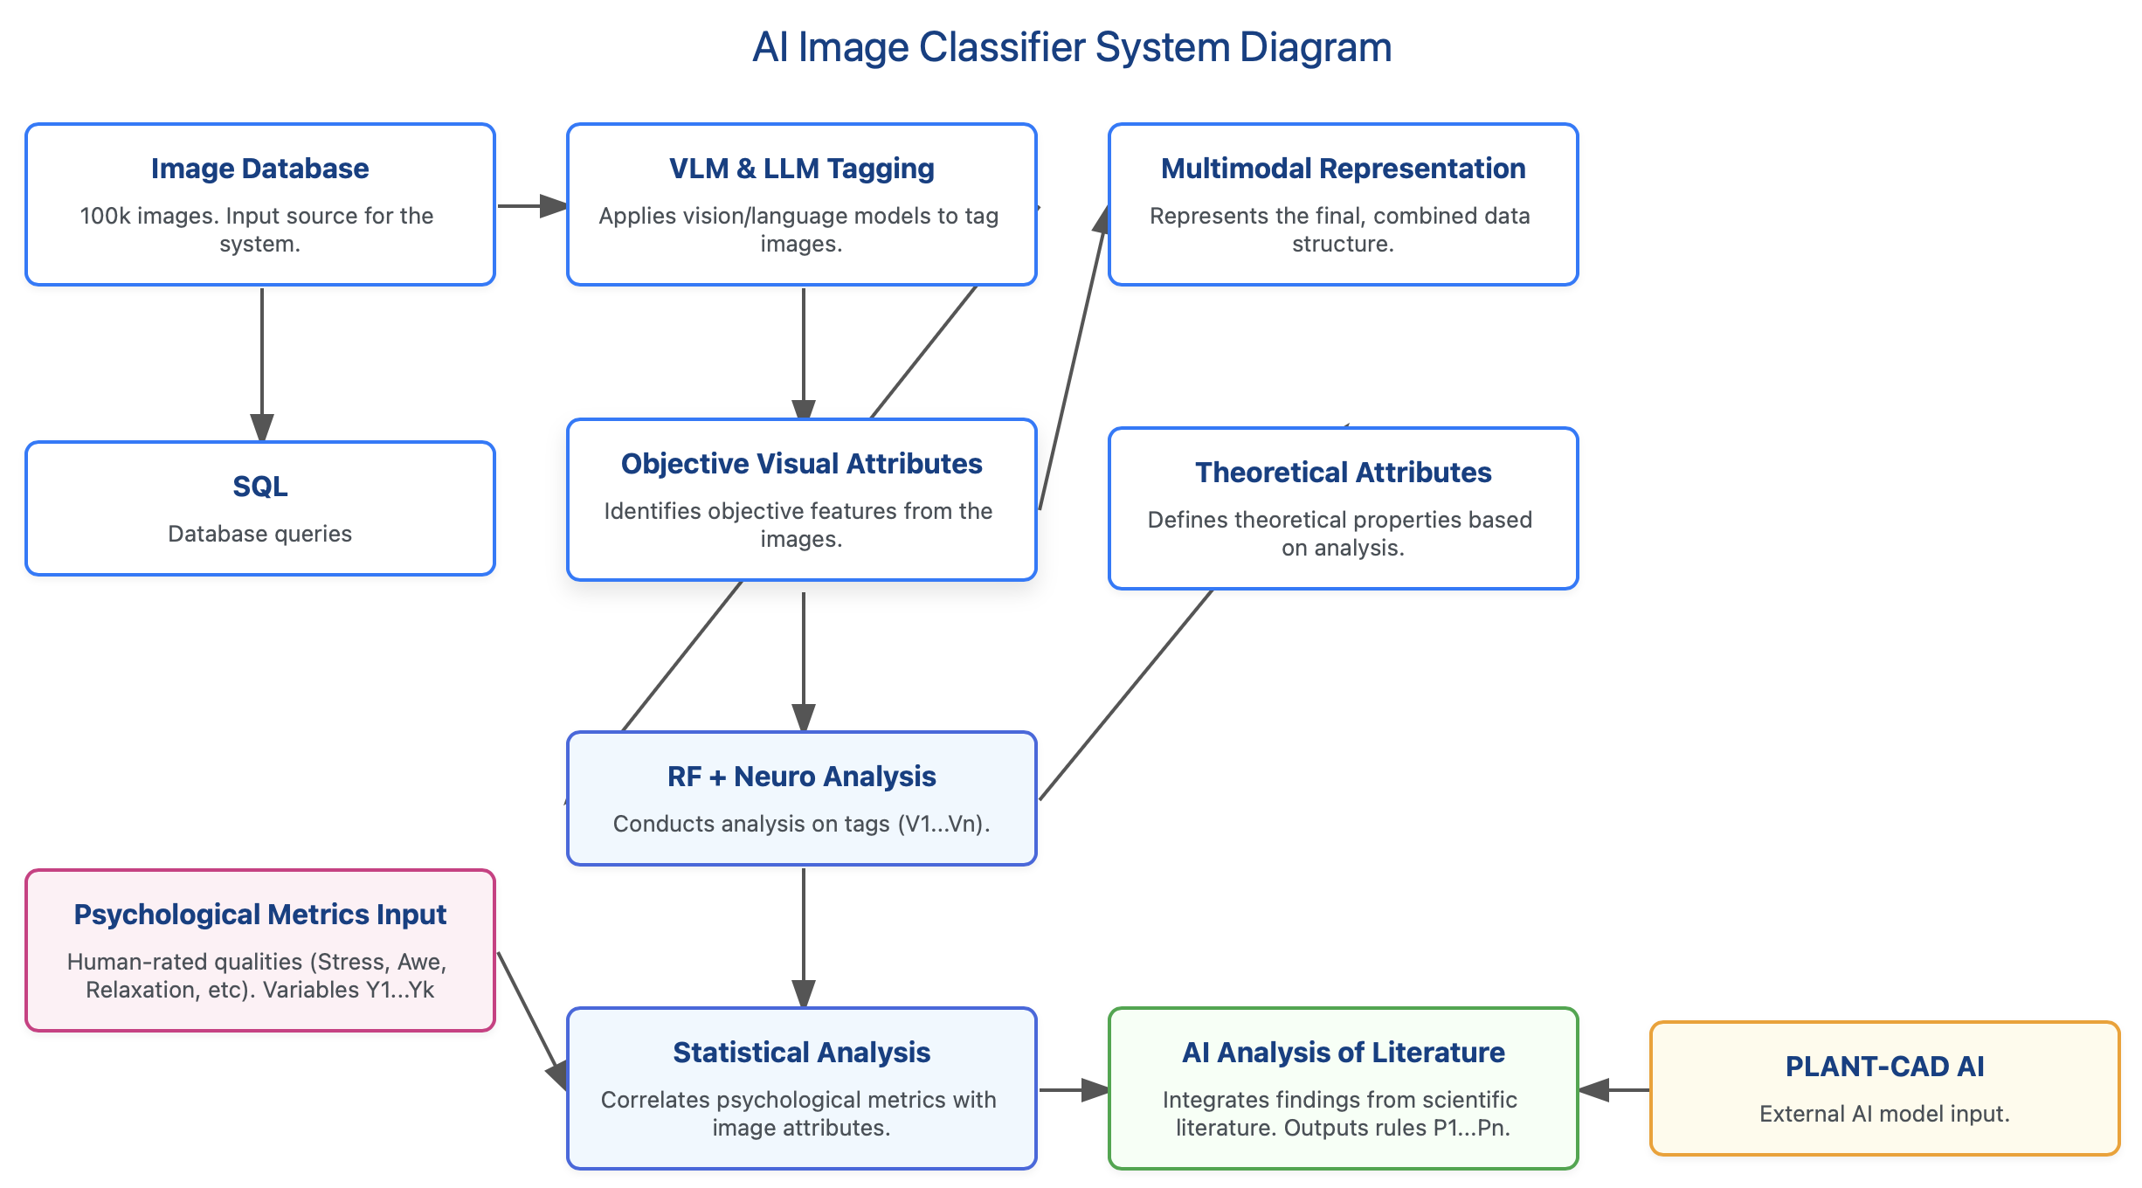

Slide 36
Meeting functional needs

Slide 37
Image
Visual Based Inferences
All things considered Inferences
AI: generated
1000’s of
Physical
Tags
AI analyzed
Science
Probable
Cognitive Effects
Probable
Cog Effects
What
Experimental
Science
Tells Us
Plants
Floor to Ceiling windows
Curvilinear
Shapes
Ceiling Height
Furniture
Visible acoustic treatments
Color
Materials
Texture
Flooring
Probable
Emotional Effects
Probable
Emotional Effects
Probable
Neuro Effects
Multimodal Interaction
Probable
Neuro Effects
Complex
Statistical
Analysis
Probable
Social Interaction
Probable
Social Interaction
Well designed for following Activities
Well designed for following Activities

Slide 38
Image
AI: generated
1000’s of
Physical
Tags
Plants
Floor to Ceiling windows
Curvilinear
Shapes
Ceiling Height
Furniture
Visible acoustic treatments
Color
Materials
Texture
Flooring
… 100’s more

Slide 39
Image
Visual Based Inferences
AI: generated
1000’s of
Physical
Tags
AI analyzed
Science
Probable
Cognitive Effects
What
Experimental
Science
Tells Us
Plants
Floor to Ceiling windows
Curvilinear
Shapes
Ceiling Height
Furniture
Visible acoustic treatments
Color
Materials
Texture
Flooring
Probable
Emotional Effects
Probable
Neuro Effects
Complex
Statistical
Analysis
Probable
Social Interaction
Well designed for following Activities

Slide 40
Visual Based Inferences
All things considered Inferences
Probable
Cognitive Effects
Probable
Cog Effects
Probable
Emotional Effects
Probable
Emotional Effects
Probable
Neuro Effects
Multimodal Interaction
Probable
Neuro Effects
Probable
Social Interaction
Probable
Social Interaction
Well designed for following Activities
Well designed for following Activities

Slide 41
So

Slide 42
Image
Visual Based Inferences
All things considered Inferences
AI: generated
1000’s of
Physical
Tags
AI analyzed
Science
Probable
Cognitive Effects
Probable
Cog Effects
What
Experimental
Science
Tells Us
Plants
Floor to Ceiling windows
Curvilinear
Shapes
Ceiling Height
Furniture
Visible acoustic treatments
Color
Materials
Texture
Flooring
Probable
Emotional Effects
Probable
Emotional Effects
Probable
Neuro Effects
Multimodal Interaction
Probable
Neuro Effects
Complex
Statistical
Analysis
Probable
Social Interaction
Probable
Social Interaction
Well designed for following Activities
Well designed for following Activities

Slide 43
What
Experimental
Science
Tells Us

Slide 44
Graphical User Interface

Slide 45
We could apply a generative AI system that takes the output of the image anallyzer as a goodness evaluator

Slide 46
Susan : neuroarts resource center
Connect people – need stims, need collaborators

Slide 47
